Slide 1
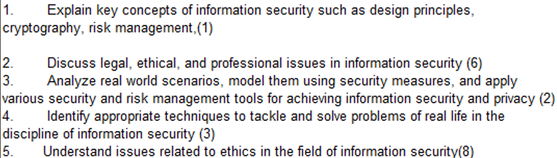
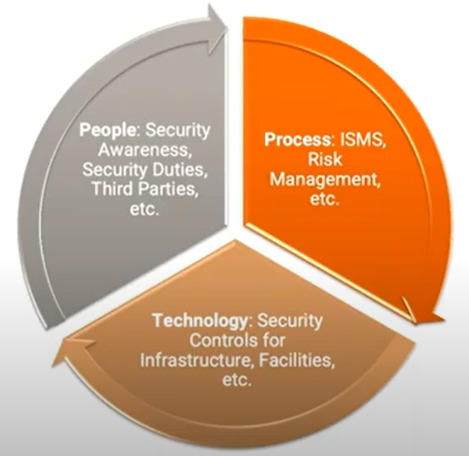
CS 3002 Information Security
Fall 2022
Week # 9 – Lecture # 22, 23, 24
20th, 21st, 22nd Rabi ul Awwal, 1444
18th, 19th, 20th October 2022
Dr. Nadeem Kafi Khan

Slide 2
Lecture # 22 - LAB
Database Access Control (Section 5.6)
Grant command
Revoke command
Discretionary vs Role-based Access control in databases
Fixed Roles in Microsoft SQL Server
Cascading Authorizations
Disclosure of database information through Inference (Section 5.7)
Understanding Inference
Case for Inference: Employee Schema

Slide 3
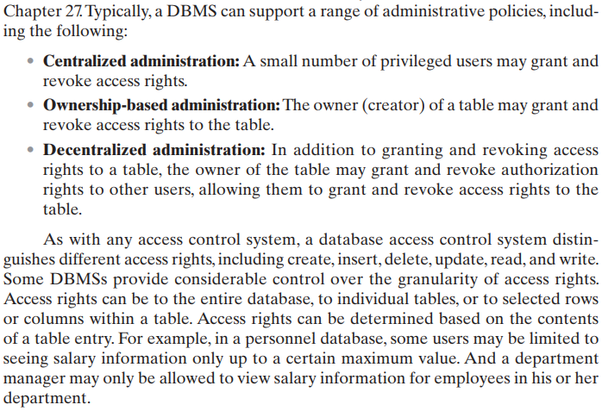

Slide 4
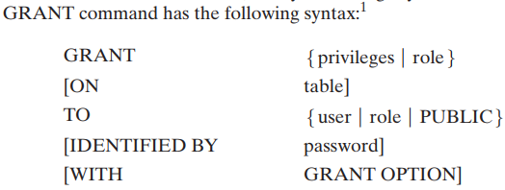
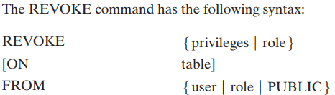
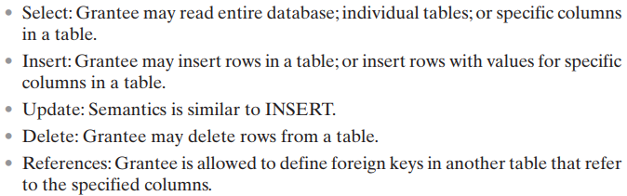

Slide 5
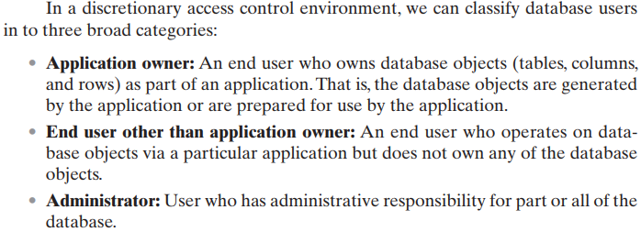

Slide 6
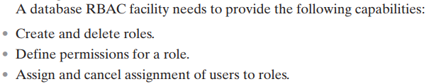
A role-based access control (RBAC) scheme is a natural fit for database access control.
Unlike a file system associated with a single or a few applications, a database system often supports dozens of applications.
In such an environment, an individual user may use a variety of applications to perform a variety of tasks, each of which requires its own set of privileges.
It would be poor administrative practice to simply grant users all of the access rights they require for all the tasks they perform.
RBAC provides a means of easing the administrative burden and improving security.

Slide 7
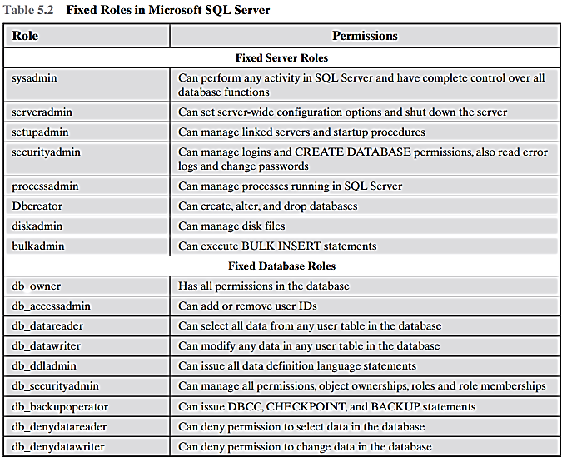

Slide 8
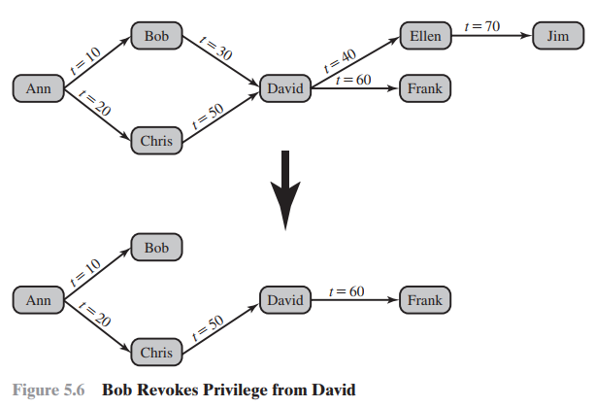
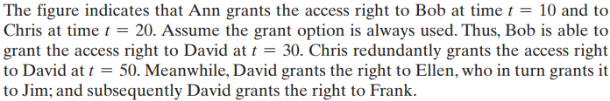
Suppose Bob revokes the privilege from David. David still has the access right because it was granted by Chris at t = 50.
The access rights to Ellen and Jim is revoked when Bob revokes the access right to David.
Why? This is because at t = 40, when David granted the access right to Ellen, David only had the grant option to do this from Bob. When Bob revokes the right, this causes all subsequent cascaded grants that are traceable solely to Bob via David to be revoked.

Slide 9

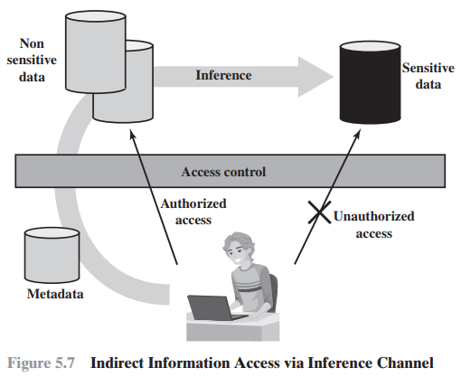
Metadata refers to knowledge about correlations or dependencies among data items that can be used to deduce information not otherwise available to a particular user.
Inference, as it relates to database security, is the process of performing authorized queries and deducing unauthorized information from the legitimate responses received.
The inference problem arises when the combination of a number of data items is more sensitive than the individual items, or when a combination of data items can be used to infer data of higher sensitivity.
Figure 5.7 illustrates the process. The attacker may make use of non sensitive data as well as metadata. The information transfer path by which unauthorized data is obtained is referred to as an inference channel.
Two inference techniques can be used to derive additional information:
Analyzing functional dependencies between attributes within a table or across tables, and
Merging views with the same constraints.

Slide 10
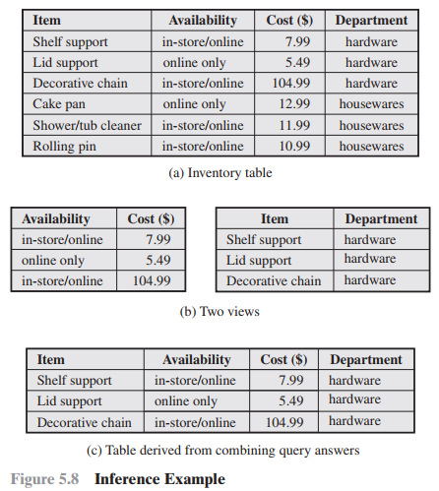
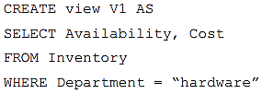
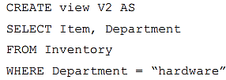
A user who knows the structure of the Inventory table and who knows that the view tables maintain the same row order as the Inventory table is then able to merge the two views to construct the table shown in Figure 5.8c. This violates the access control policy that the relationship of attributes Item and Cost must not be disclosed.

Slide 11
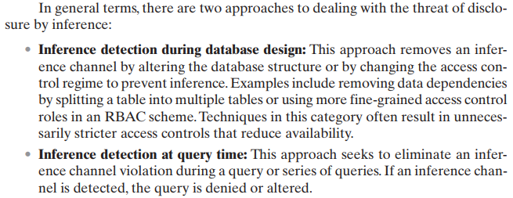
How to dead with the threat of disclosure by inference?

Slide 12
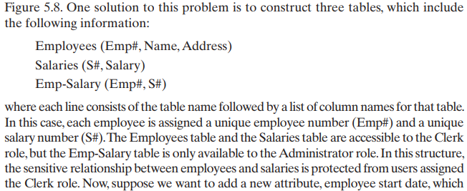
Consider a database containing personnel information, including names, addresses, and salaries of employees. Individually, the name, address, and salary information is available to a subordinate role, such as Clerk, but the association of names and salaries is restricted to a superior role, such as Administrator.
Create a small database schema to hold the above information. How we safeguard against inference?
In which table a new attribute, employee start date could be added if it is not sensitive?

Slide 13
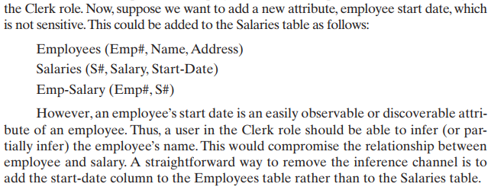
Consider a database containing personnel information, including names, addresses, and salaries of employees. Individually, the name, address, and salary information is available to a subordinate role, such as Clerk, but the association of names and salaries is restricted to a superior role, such as Administrator.
In which table a new attribute, employee start date could be added if it is not sensitive?

Slide 14
Lecture # 23
Database Encryption (Section 5.7)
Actors in a Database Encryption Scheme
Whole Database Encryption Scheme (Figure 5.9)
Row Encryption Scheme (Figure 5.10, Table 5.3)
How row-wise encryption scheme works?
Performance and other improvements

Slide 15
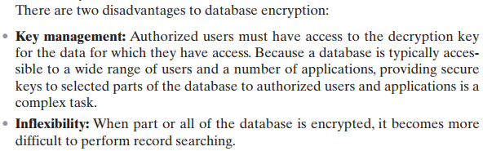
Encryption becomes the last line of defense in database security.
Encryption can be applied to the (i) entire database, (ii) at the record level (encrypt selected records), (iii) at the attribute level (encrypt selected columns), or at the level of the individual field.

Slide 16
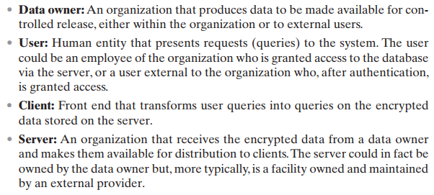
Actors in a Database Encryption Scheme

Slide 17
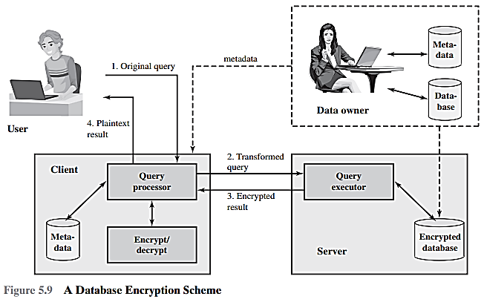

Slide 18


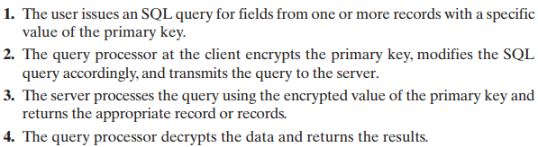
1.
Assume the encryption key k is used and the encrypted value of the department id 15 is E(k, 15) = 1000110111001110.
2.
3.
If the user wishes to retrieve all records for salaries less than $70K. There is no obvious way to do this, because the attribute value for salary in each record is encrypted. The set of encrypted values do not preserve the ordering of values in the original attribute.
4.

Slide 19
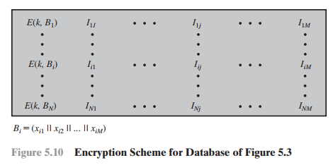
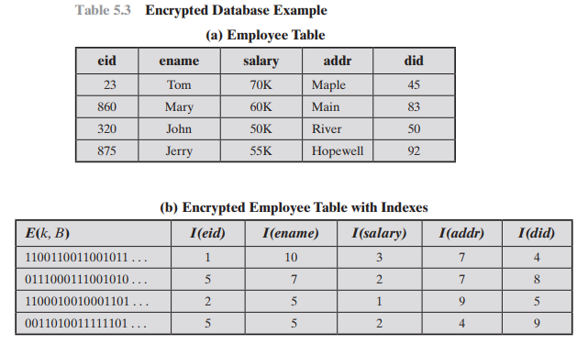
Alternate Approach (1)
Each row Ri is treated as a contiguous block forming a sequence of bits, and all of the attribute values for that row are concatenated together to form a single binary block.
The entire row is encrypted.
Shown as I_{i1}, I_{i2}, I_{i3}, … are indexes are associated with each attribute of the table.

Slide 20
Alternate Approach (2)
Suppose employee ID (eid) values lie in the range [1, 1000].
We can divide these values into five partitions: [1, 200], [201, 400], [401, 600], [601, 800], and [801, 1000]; then assign index values 1,2, 3, 4, and 5, respectively.
23 → partition 1
860 → partition 5
320 → partition 2
875 → partition 5

Slide 21
Alternate Approach (3)
This arrangement provides for more efficient data retrieval. Suppose, for example, a user requests records for all employees with eid < 300.
The query processor requests all records with I(eid) = 2.
These are returned by the server.
The query processor decrypts all rows returned, discards those that do not match the original query, and returns the requested unencrypted data to the user.
The indexing scheme just described does provide a certain amount of information to an attacker, namely a rough relative ordering of rows by a given attribute. To obscure such information, the ordering of indexes can be randomized.
For example, the eid values could be partitioned by mapping [1, 200], [201, 400], [401, 600], [601, 800], and [801, 1000] into 2, 3, 5, 1, and 4, respectively. Because the metadata are not stored at the server, an attacker could not gain this information from the server.

Slide 22
Alternate Approach (4)
To increase the efficiency of accessing records by means of the primary key, the system could use the encrypted value of the primary key attribute values, or a hash value.
In either case, the row corresponding to the primary key value could be retrieved individually.
Different portions of the database could be encrypted with different keys, so users would only have access to that portion of the database for which they had the decryption key.
This latter scheme could be incorporated into a role-based access control system.

Slide 23
Lecture # 24
Malicious Software (a.k.a Malware) (Chapter 6)
Definition
Terminology of Malware (Table 6.1)
Attack Sources and Attack Kits
Classifying Malware
How it propagates?
What are the malicious contents (payload)?
Other classifications
Blended Attacks, Advanced Persistent Threats (APTs)
E.g. Stuxnet

Slide 24
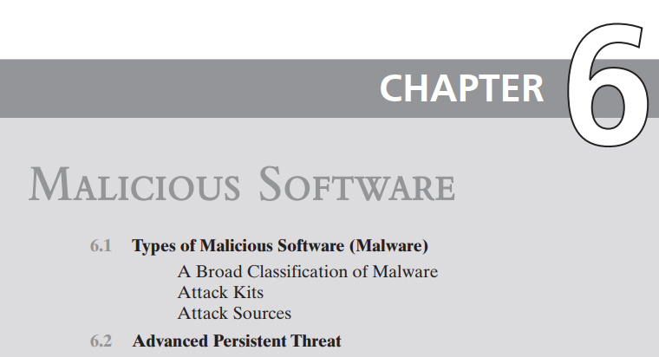
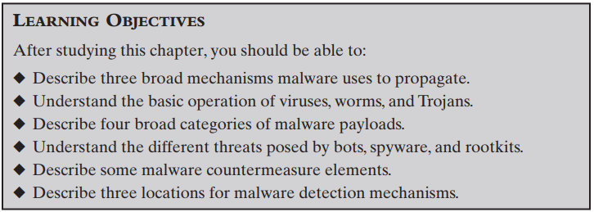

Slide 25
Malicious Software or Malware
Definition: “a program that is inserted into a system, usually covertly, with the intent of compromising the confidentiality, integrity, or availability of the victim’s data, applications, or operating system or otherwise annoying or disrupting the victim.”
Malware poses threats to
application programs,
utility programs such as editors and compilers, and
kernel-level programs.
Malware might be used on
compromised or malicious websites and servers,
spam e-mails or other messages to trick users into revealing sensitive personal info.

Slide 26
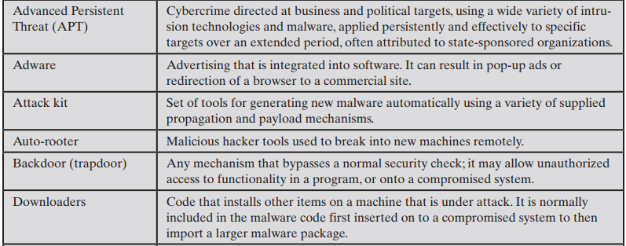

Slide 27
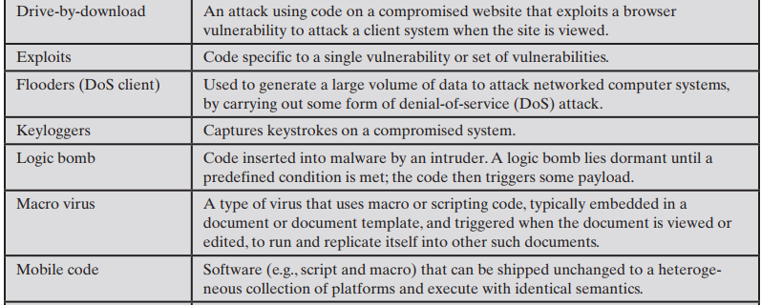

Slide 28
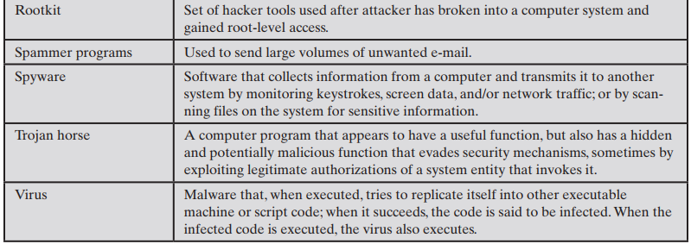

Slide 29
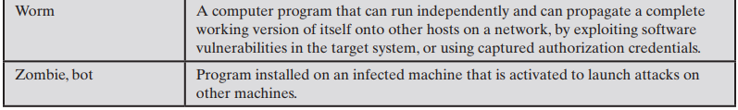

Slide 30
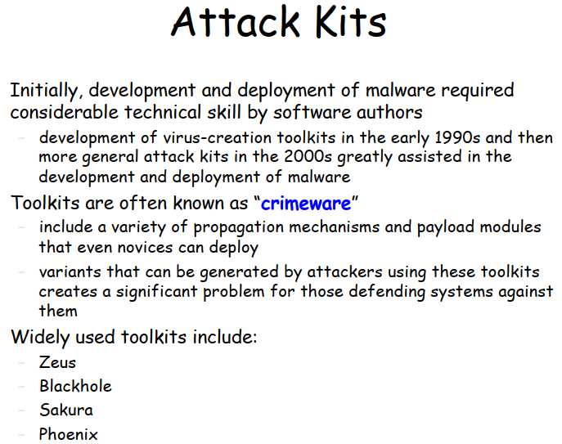

Slide 31
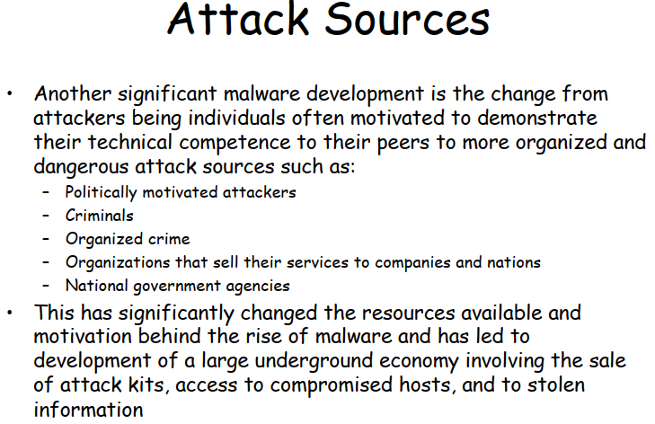

Slide 32
Malware classification is based on
The way it spread or propagate
Virus infects existing executable that is subsequently spread to other systems;
exploit of software vulnerabilities either locally or over a network by worms or drive-by-downloads to allow the malware to replicate; and
social engineering attacks that convince users to bypass security mechanisms to install Trojans, or to respond to phishing attacks.
The variety of actions or payloads used once it has reached a target.
corruption of system or data files;
theft of service in order to make the system a zombie agent of attack (Botnet);
theft of information from the system, especially of logins, passwords, or other personal details by keylogging or spyware programs; and
stealthing where the malware hides its presence on the system from attempts to detect and block it.

Slide 33
Also classified by
those that need a host program (parasitic code such as viruses)
those that are independent, self-contained programs (worms, trojans, and bots)
malware that does not replicate (trojans and spam e-mail)
malware that does replicate (viruses and worms)
A blended attack uses multiple methods of infection or propagation to maximize the speed of contagion and the severity of the attack. Some malware even support an update mechanism that allows it to change the range of propagation and payload mechanisms utilized once deployed.
Stuxnet is a malicious computer worm first uncovered in 2010 and thought to have been in development since at least 2005. Stuxnet targets supervisory control and data acquisition systems and is believed to be responsible for causing substantial damage to the nuclear program of Iran.

Slide 34
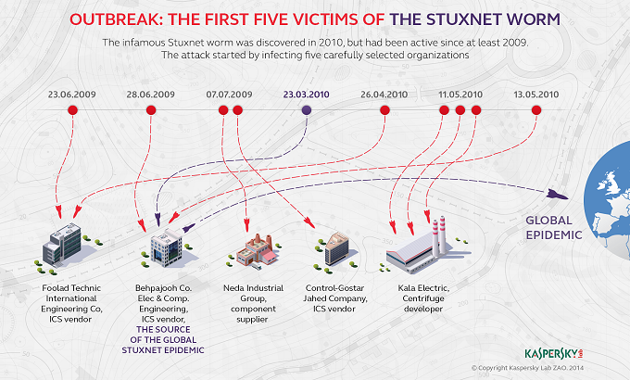

Slide 35
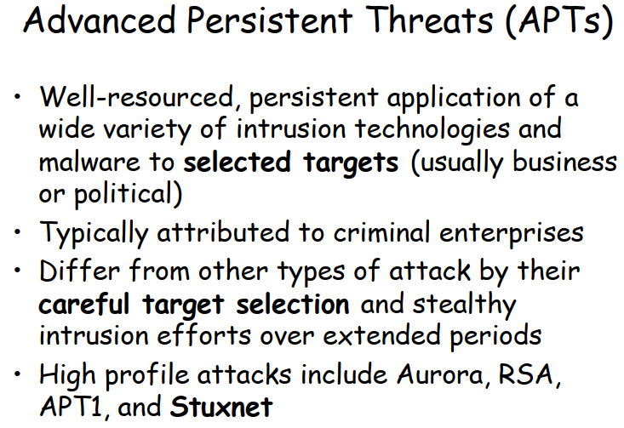

Slide 36
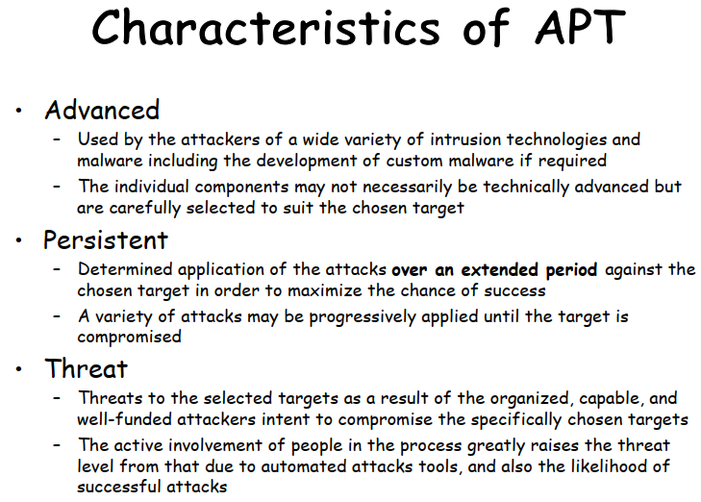

Slide 37
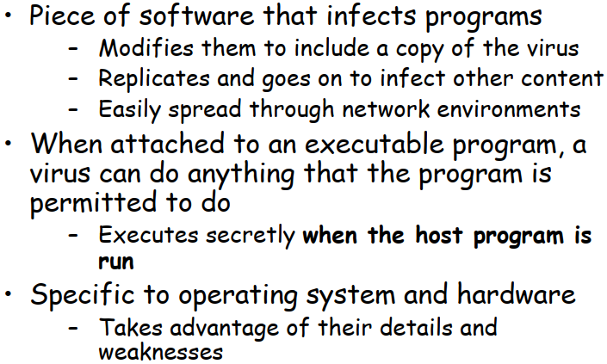

Biological viruses are tiny scraps of genetic code—DNA or RNA—that can take over the machinery of a living cell and trick it into making thousands of flawless replicas of the original virus.

